Slide 1



Find matching water treatment solutions
for client requests by using the products catalogs

Slide 2
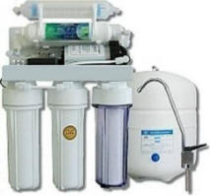
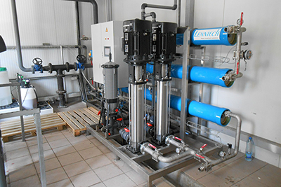
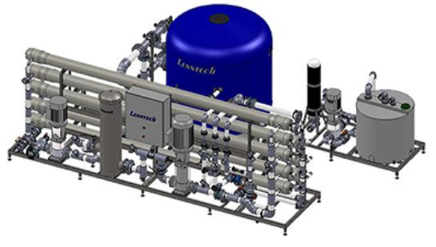
Water treatment solutions

Slide 3
Water treatment solutions
800.000 products

Slide 4
Example request
Provide us with a reverse osmosis membrane for the given specifications:
- 45.4 m3/day production:
- 99.5% salt rejection
- maximum operating pressure of 600 psi
- 8-inch diameter
- pH range of 2-11
The following reverse osmosis membranes from the brands Toray, DuPont, CSM, Hydranautics, or SUEZ can be considered

Slide 5
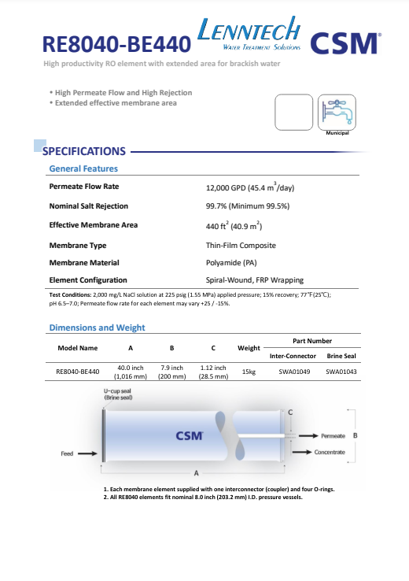
Suggestion
RE8040-BE440
[Data-sheets/CSM-RE8040-BE440-L.pdf]

Slide 6
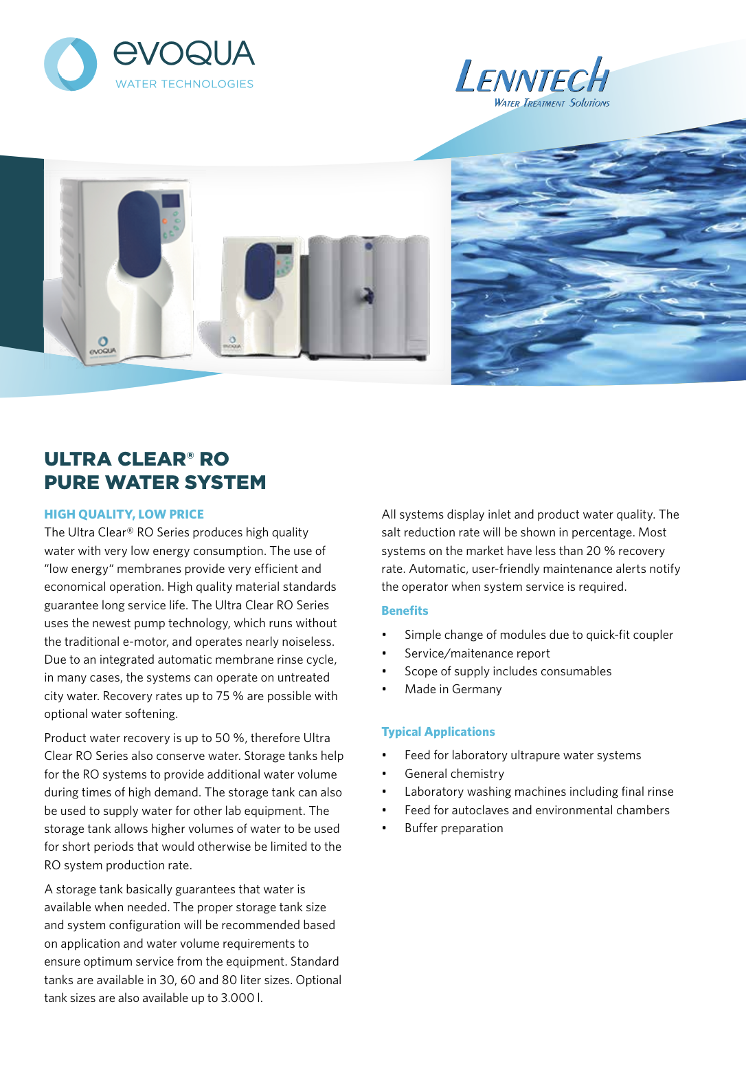
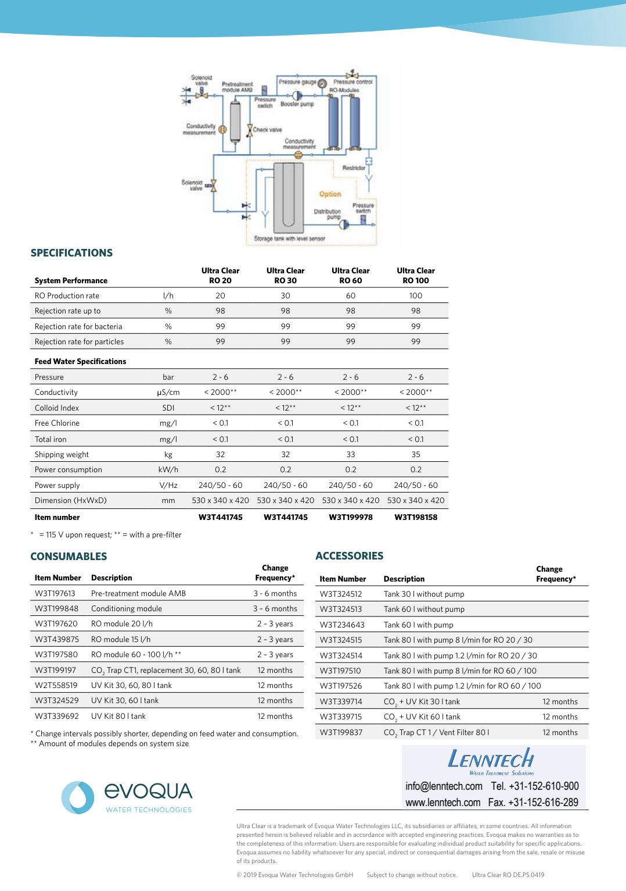
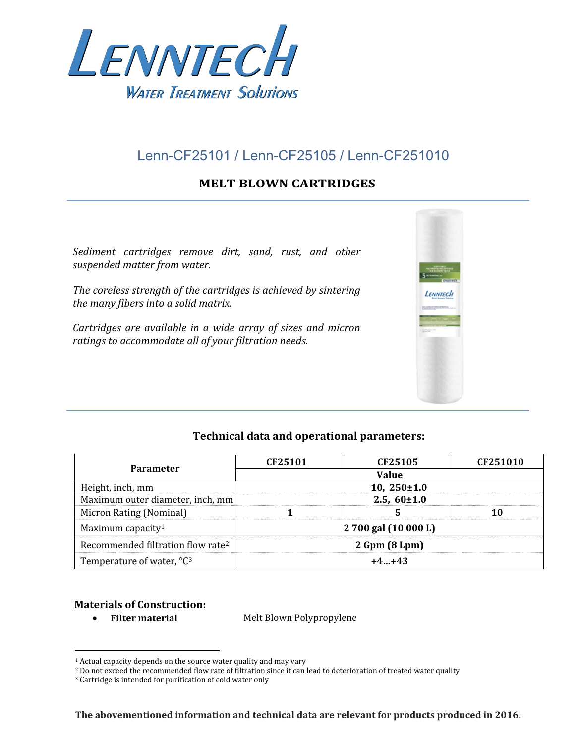
Dataset
Contains ~30gb of web pages and pdf datasheets for products

Slide 7



Analyze Client's Request
Match with Product Datasheets
Recommend Suitable Products
Assignment
Bonus: explain the recommendation / consider product prices

Slide 8
Good luck!

